Slide 1
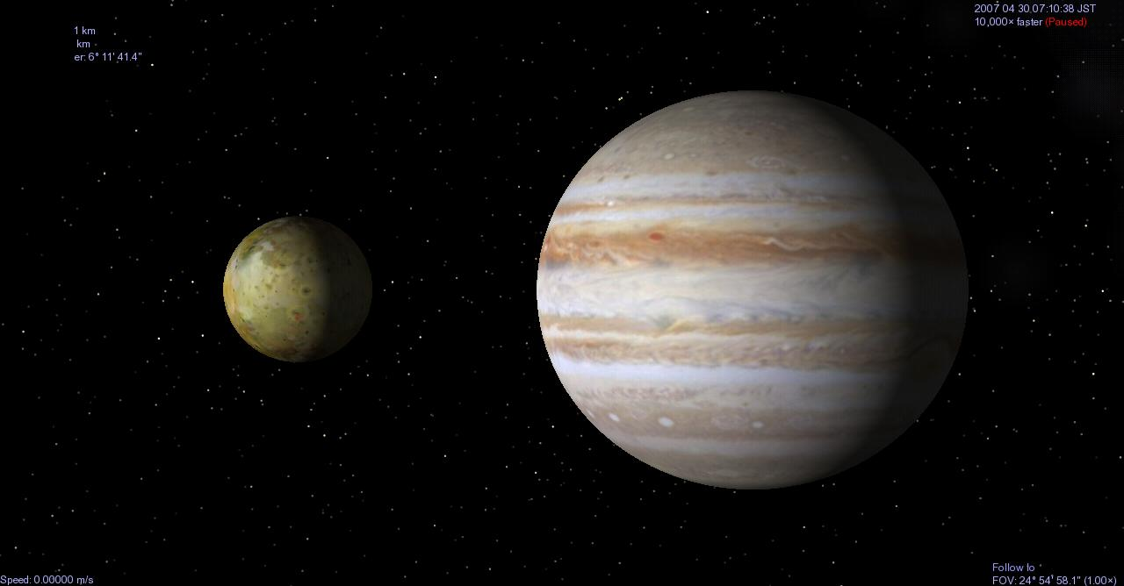
Mid-infrared observations of Io’s volcanic activity from the ground
Mizuki Yoneda
Planetary Plasma and Atmospheric Research Center
Graduate School of Science, Tohoku University, Japan
Takashi Miyata
Institute of Astronomy, the University of Tokyo, Japan
Notes:
Finally, I talk about my study.
My study is based on ground-based observations for Io’s volcanic activity and Io’s atmospheric escape.

Slide 2
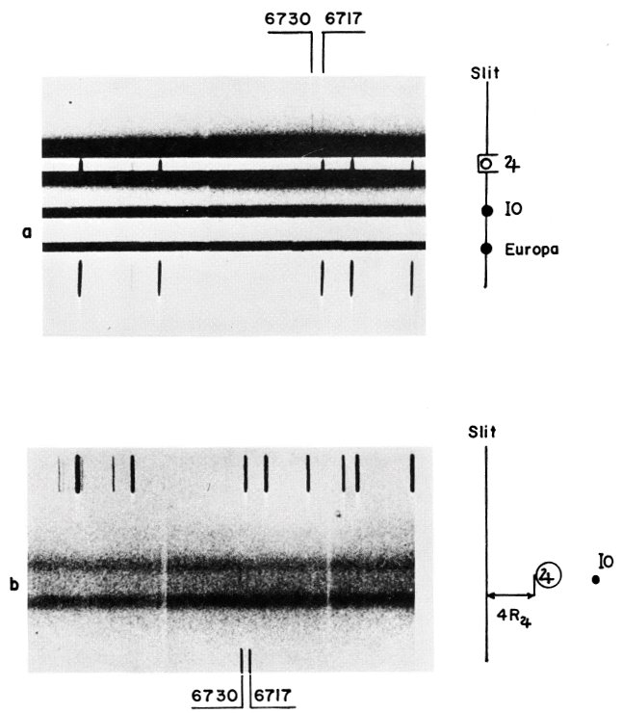
The first detection of heavy ions in Jupiter’s magnetosphere
Kupo et al. (1976)
Emissions from S+ were found from the ground. It was earlier than the discovery of Io’s volcanoes by Voyager 1.
Fig. 1. Spectroscopic images obtained around Jupiter from the ground by Kupo et al. (1976).
Notes:
First detection of heavy ions was by ground-based observations by Kupo et al. from Tel Aviv university.
This observation was made in 1975, this was before the encounter of Voyager 1 at Jupiter.
But anyway, heavy ions in Jupiter’s magnetosphere has been known before the Voyager.
I don’t know why this team disappeared from the history of Jupiter’s magnetosphere.
But their work showed that ground-based observations can be forerunner of spacecraft.

Slide 3
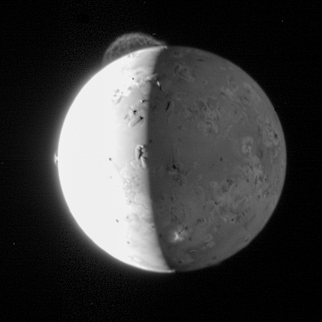
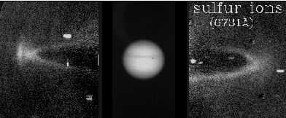
Jupiter's magnetosphere has a plasma source inside.
Io's volcanoes
Io's atmosphere / ionosphere
Jupiter's inner magnetosphere
(Io plasma torus)
Fig. 3. Io's volcanic plumes obtained by the New Horizons spacecraft.
Inner/outer magnetosphere
Io plasma torus
Fig. 2. An image of [SII] 673.1 nm emission from Io plasma torus (Schneider and Trauger, 1995).
Notes:
Volcanoes on Io produce gas, and it becomes Io’s atmosphere.
This atmosphere is ionized and becomes ionospheric plasma.
This plasma is picked up by Jupiter’s co-rotating magnetic fields.
Then it becomes Jupiter’s magnetospheric plasma.

Slide 4
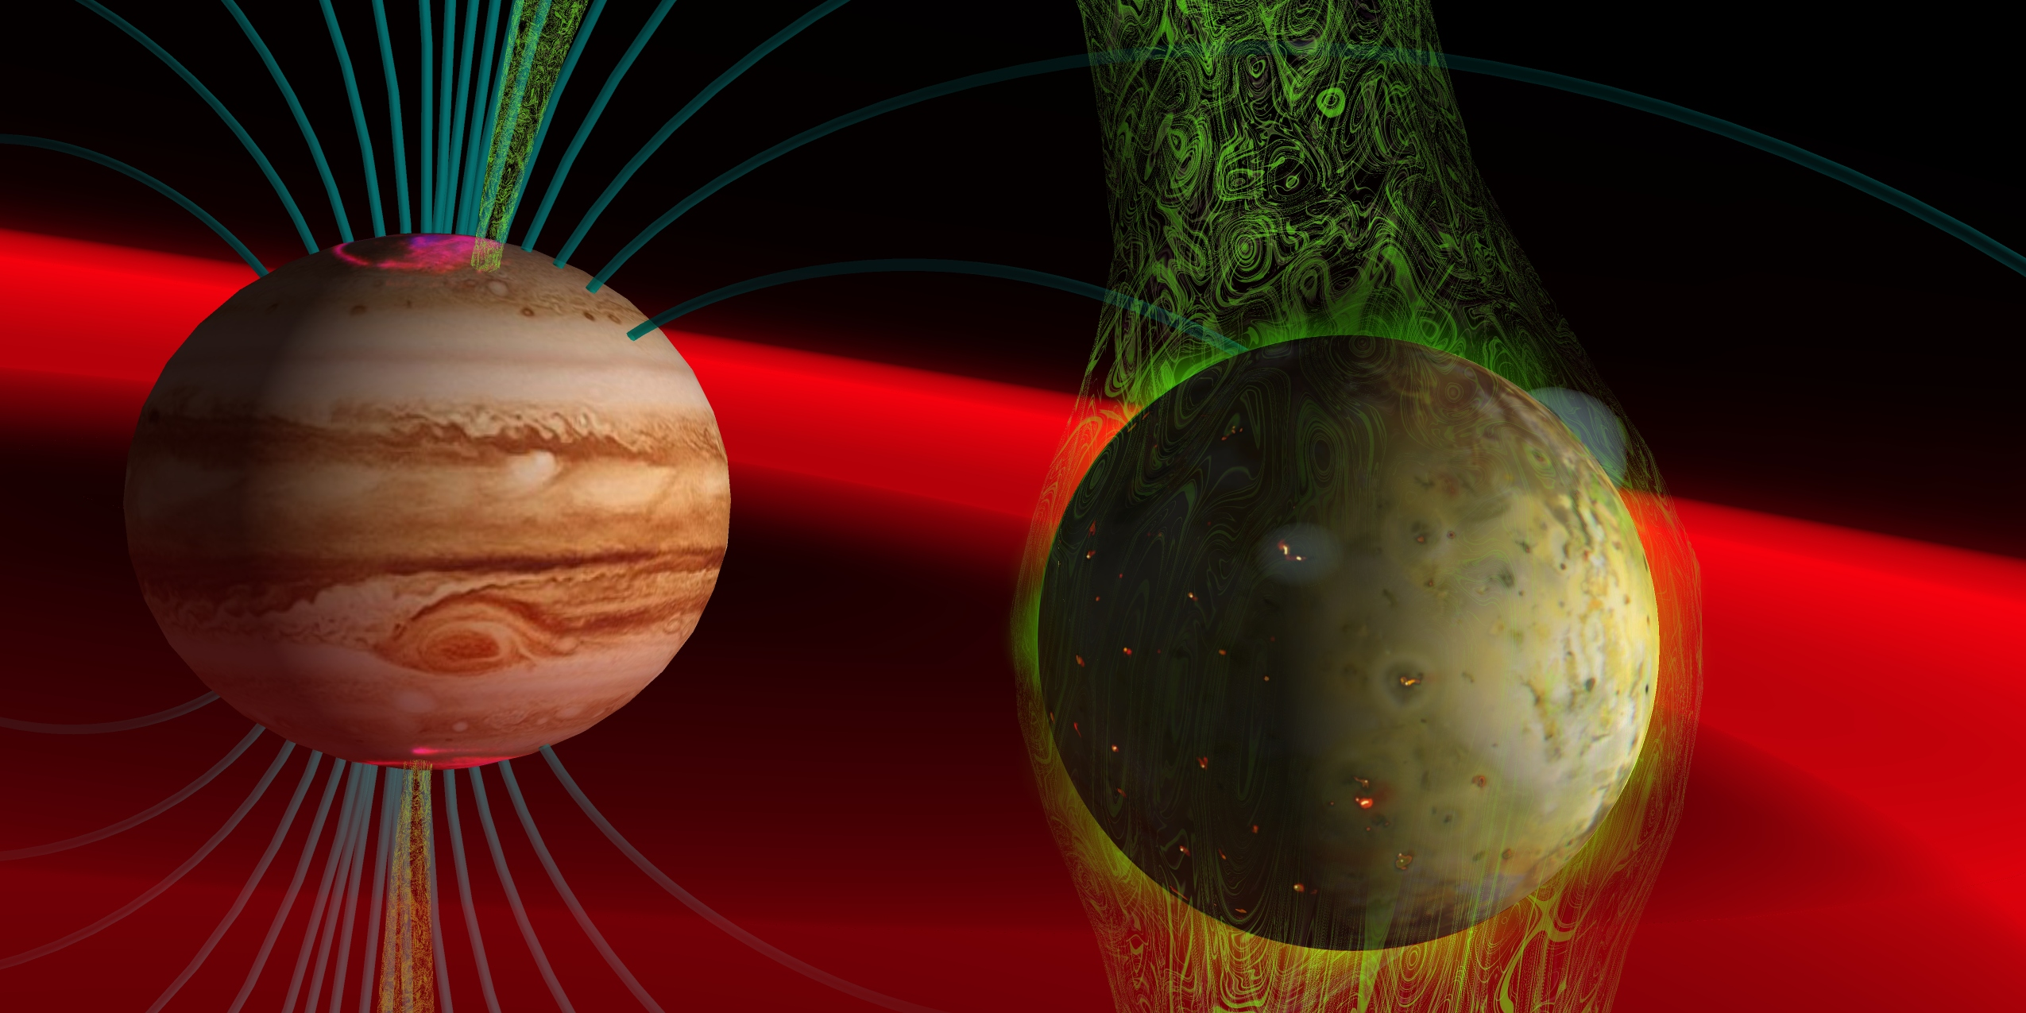
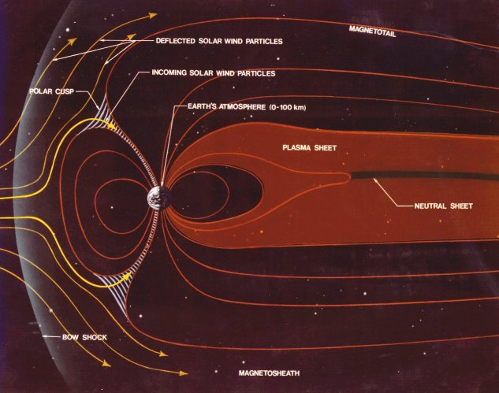
木星磁気圏現象 → 太陽活動・イオ火山活動に依存
Keywords: オーロラ、磁気圏電波放射、磁気圏プラズマ、イオ火山、etc.
「イオの火山活動 → 木星磁気圏」を統一的に観測したい!
木星内部磁気圏
Spencer's Astronomical Visualizations
JPL, NASA
Notes:
Not only as a plasma source, Io is important as a source of the neutrals.
This is an image of D line emissions from neutral sodium clouds around Jupiter.
The size of this image is 1,000 jovian radii.
This means these sodium atoms have enough velocity to escape from Jupiter’s gravitational sphere.
In Io’s volcanic gas, sodium chloride is included.
These become sodium chloride ions in the ionosphere.
Then they go into Io plasma torus.
In this torus, they collide with ambient electrons.
Then fast sodium atoms are produced. And they form this sodium nebula.

Slide 5
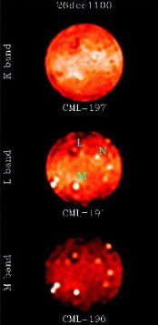
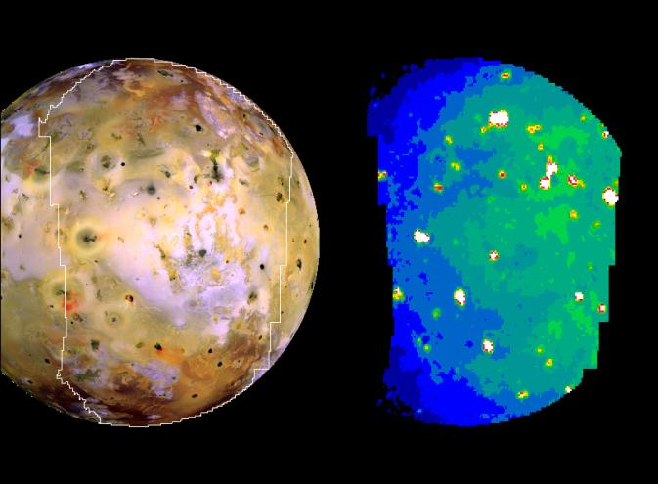
イオ火山の観測
噴火口：1500K
溶岩:600K
2-5μm 近赤外線で観測されることが多い。
}
Keck による観測( with AO)
ただし、近赤外線では太陽光の反射フラックスも無視できない。
火山とその周囲を分離できる位の空間分解能があればよい。
イオの視直径 1秒角
→大型望遠鏡か近くに行く探査機が必要。
ガリレオ探査機による可視光・近赤外線イメージ
Marchis et al., 2005

Slide 6
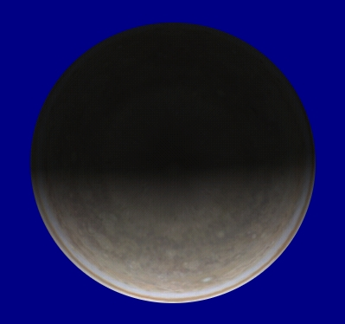
Motivation
探査機：それほど頻繁に木星へは行かない。
大型望遠鏡：マシンタイム少なし。
小型の装置でも良いので、長期的・高時間分解能で観測したい。
IRTF などで、個々の火山分離を重点化しない、近赤外線観測が行われた例はある。
However...
Observation of Io's volcanic activity is usually made in near infrared ( 2-5 microns) , but solar flux in near infrared is not negligible.
In addition,
Fig. 8. Geometry among Jupiter, Io, Earth, and Sun for observations of Io's volcanoes in near infrared.
Io's rotation period = revolution period
Only Jupiter-facing hemisphere can be observed.

Slide 7
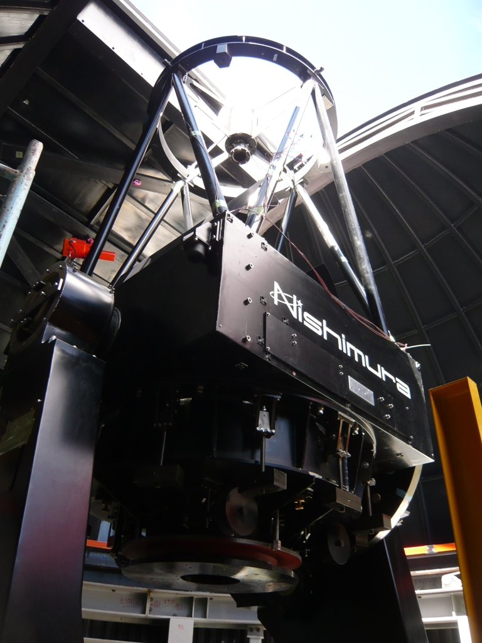
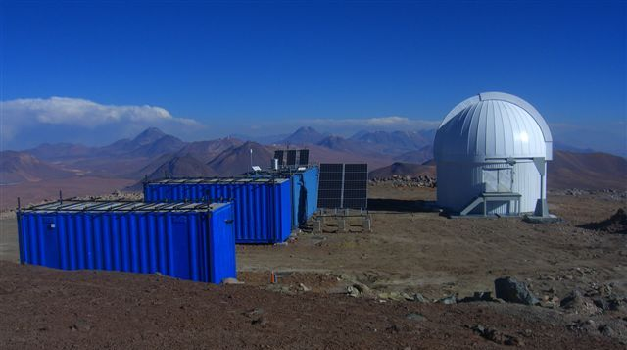
Mid infrared observation of Io's volcanic activity
We made mid infrared observations to monitor Io's volcanic activity because the solar flux in mid infrared is negligible.
12.2 μm: Peak of thermal emission at 250 K
8.9 μm: 320 K
Temperature achieved only with the solar flux is
S: Solar constant
R: Distance from the sun
A: Albedo
ε: Emissivity
σ: Stefan-Boltzmann constant
A=0.5 then T= 150[K]
Fig. 9. mini TAO 1-m telescope.
Fig. 8. Scenery around TAO observatory.

Slide 8
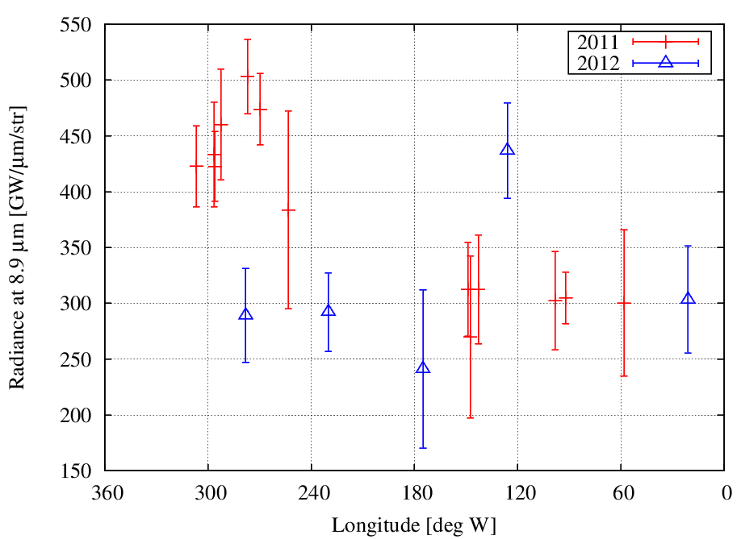
Results : 2011
Io had been detected with brightness of 20-30[Jy].
Nov 3rd
Nov 1st
Nov 11th
Nov 4th
Oct 31st
Nov 10th
Nov 8th
Nov 9th
Fig. 10. Radiance of Io as a function of Io’s central longitude at 8.9 microns obtained from observations in November 20１１.

Slide 9
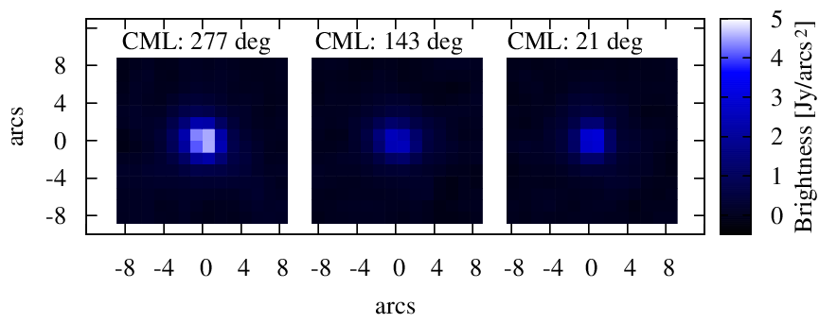
Discussion
A large flux was seen around CML 277 deg in 2011.
The most distinct volcano Loki is at CML 308 deg.
We seem to have found a volcano activated, but it’s other than Loki.
Fig. 11. Images of Io at 8.9 microns at 3 central meridian longitudes.

Slide 10
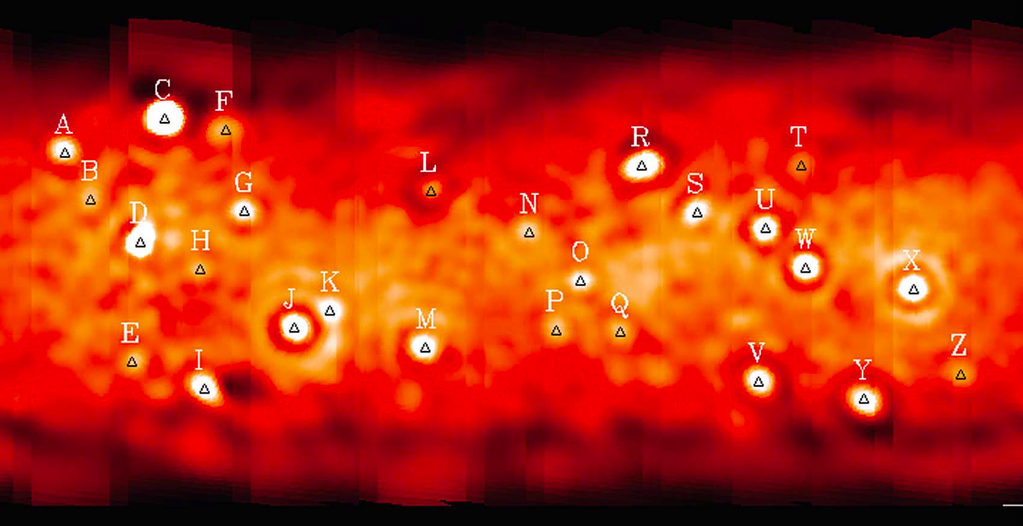
Loki なのか？
どうやら、Daedalus という火山らしい。
Loki
Keck によるL-band イオ、火山マップ (Marchis et al., 2005)

Slide 11
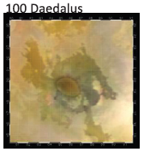
Discussion
What volcano is the most likely?
Hotspot named “Daedalus”
Hotspot at 281 ± 6 deg long & 18 ± 3 deg N lat was seen in data from Voyager 1, Galileo, and Keck. (e.g., Veeder et al. 2011)
Fig. 13. Visible image of Daedalus taken by the Galileo spacecraft (Veeder et al., 2011).

Slide 12
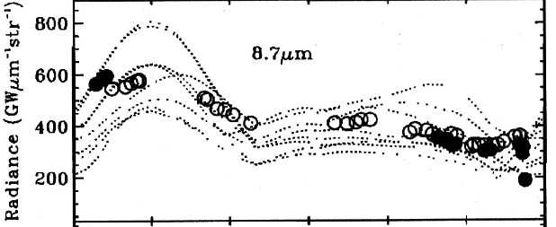
Discussion
The flux seen in Daedalus is comparable to that of Loki!
Loki
Daedalus
Fig. 14. Radiance of Io at 8.7 microns observed from IRTF as a function of the longitude in periods of 1983-1993 and 1999 (Howell et al., 2000).
Fig. 10. Radiance of Io at 8.9 microns obtained in this work.

Slide 13
Summary
We found an enhancement in Daedalus activity in 2011.
Daedalus had believed to be much less powerful volcano than Loki.
However, the radiance from Daedalus was very comparable to that of Loki.
Volcanic activity on Io has been observed by the spacecraft and large telescopes ( Voyager, Galileo, New Horizons, HST, KECK, IRTF and etc. )
この仕事は1m望遠鏡でできてしまった！
The highest cost performance yet achieved!

Slide 14
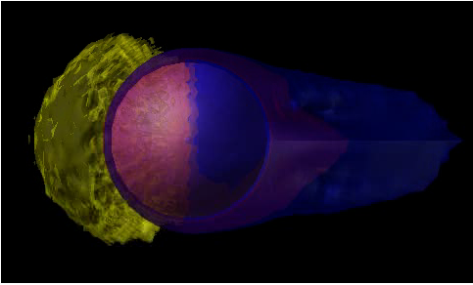
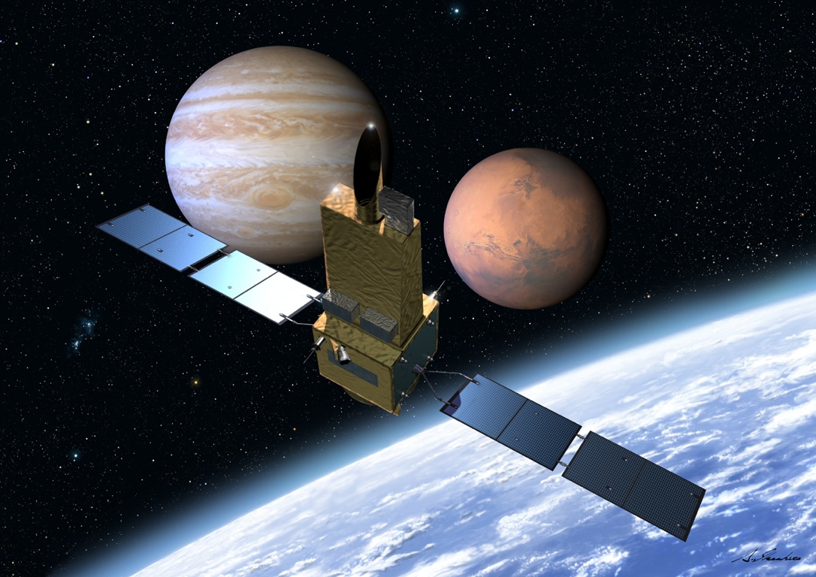
EXCEED/Sprint-A Mission
An earth-orbiting Extreme Ultraviolet (EUV) spectroscopic mission
The first mission of the ISAS/JAXA small scientific satellite series (Sprint-A)
Primary science targets
(1) Simultaneous observation of aurora and Io plasma torus
(2) Simultaneous observation of exosphere, ionosphere, and escaping plasma down the tail (Venus, Mars)
- Project Scientist: I. Yoshikawa (Univ. of Tokyo)
- Launching : Aug. 2013
- Size：1m×1m×4m
- Orbit：950km×1150km, Inc=31 deg
- Mission life ：>1 year
- Pointing accuracy : ±5arc-sec
- Wave length range：60-145nm
charge exchange
（solar wind）
slit
O⁺ 83nm resonant scattering
(ionosphere)
O⁺ 83nm resonant scattering
（escaping plasma）
H 121nm resonant scattering
O 130nm resonant scattering
(exospheric neutral particle)
Allowed transition lines of S,O ions
FUV/EUV aurora
H₂ Lyman & Werner bands
Io plasma torus : Cassini/UVIS
Jupiter’s UV aurora : HST/WFPC2
slit

Slide 15
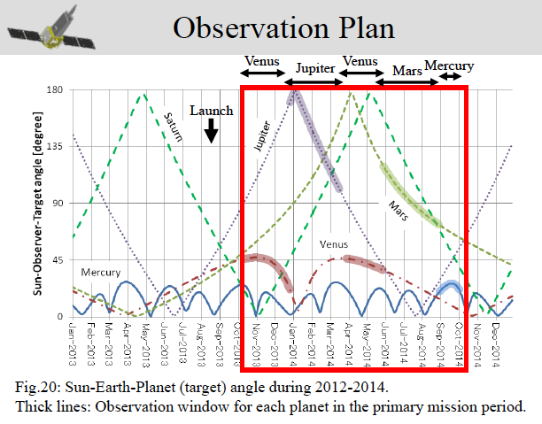
miniTAO/EXCEED 観測時期を近づけたい。

